Slide 1
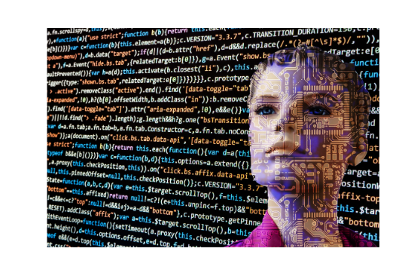
Intelligent Document Processing
By Aafreen Kazi

Slide 2


About CRISIL Ltd.

Slide 3
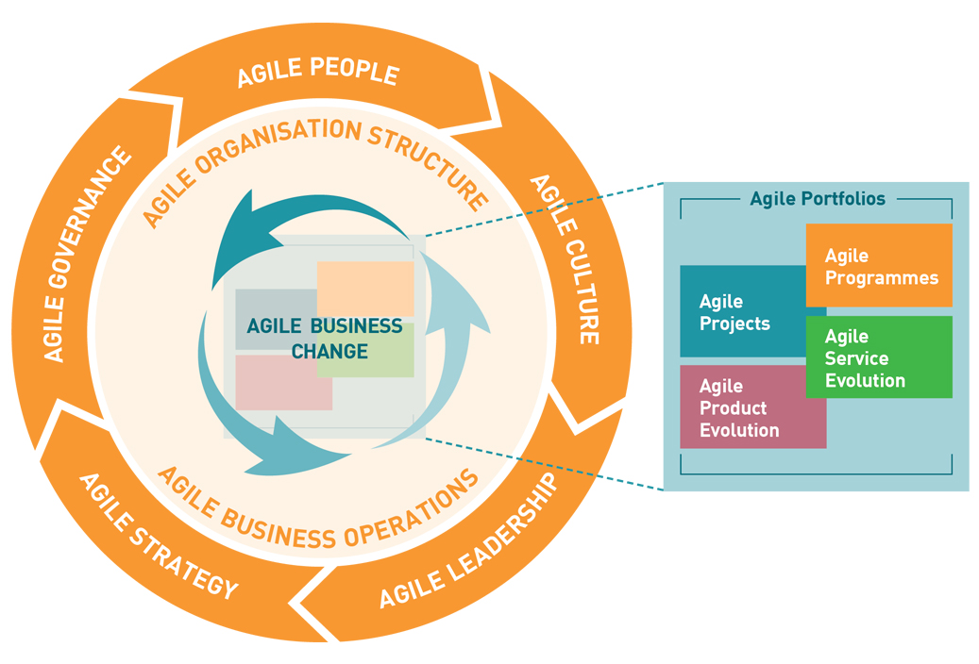
Agile Work Culture

Slide 4

What is Intelligent Document Processing (IDP)?

Slide 5
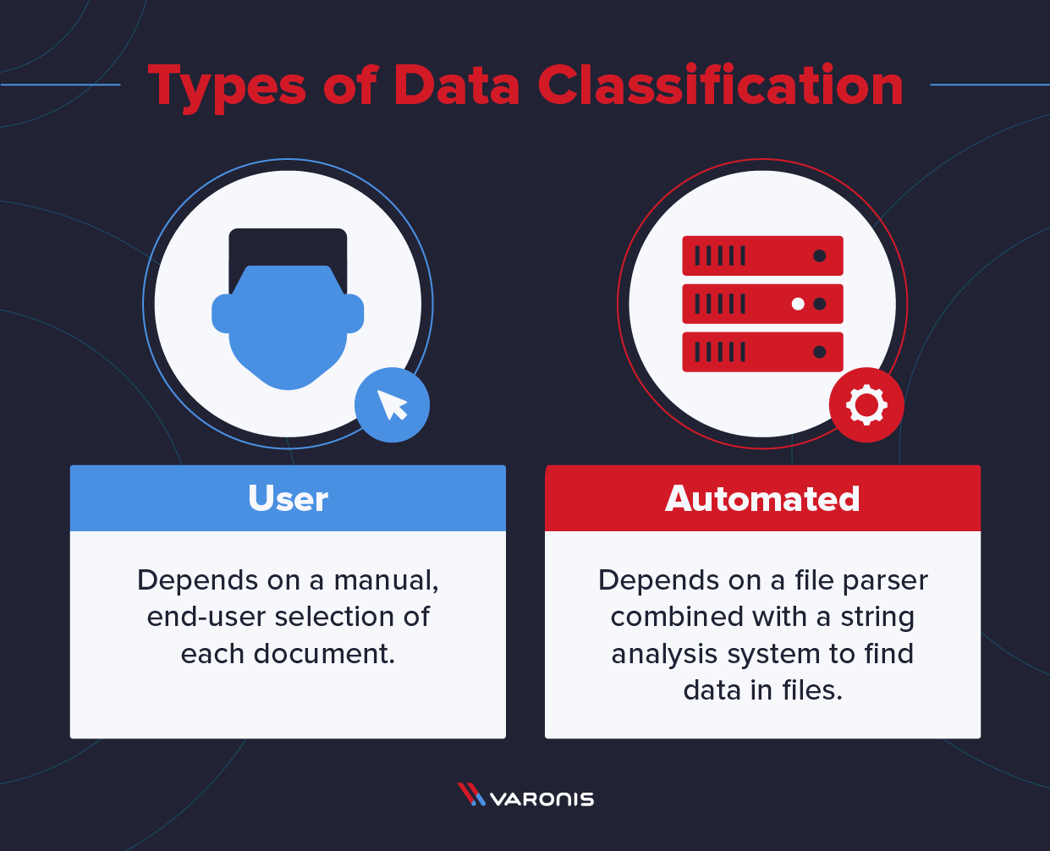
Why Business Organizations are trying to adopt IDP

Slide 6
Overview of the Workflow in 3 Simple Steps
Step 1
Step 2
Step 3
Data generation, pre-processing and EDA
Study and implementation of deep learning and sequence models
Evaluating the model’s performance

Slide 7
Workflow of the Product

Slide 8
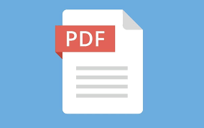

Data Collection and Conversion

Slide 9
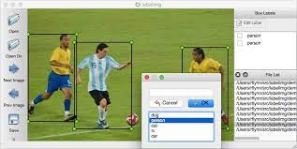
Image Data Labelling

Slide 10


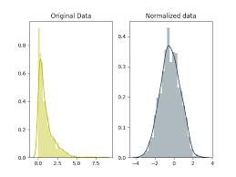
Image Pre-processing
Image Resizing
Image Normalization

Slide 11

Image to Text Conversion

Slide 12
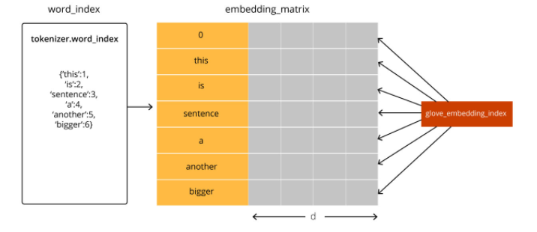
Text Pre-processing

Slide 13
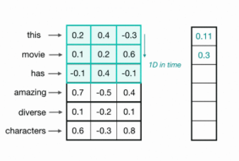
Text Classification - 1D CNN

Slide 14
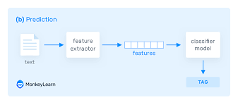
Text Classification

Slide 15
Evaluation of the model
Accuracy
Loss
BLEU’s Score
The number of correctly classified labels divided by the total number of labels to be classified.
It gives a measure about how well the classification model is working on the given set of data.
t Classification)
(Text Classification
Machines learn by means of a loss function.
It's a method of evaluating how well specific algorithms model the given data.
Evaluation of the image to text model becomes a bit challenging since it differs greatly from the general classification task.
It works by comparing image to text generated by the model with a set of reference translations.

Slide 16
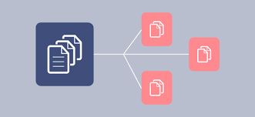
Results

Slide 17


